Slide 1


IMPLEMENTING VIRTUAL ASSISTANT USING CNN FOR TRAVEL PLANNER
UNDER THE GUIDANCE OF
Dr. D Santhosh Kumar
Assistant Professor, ECE
VNRVJIET
PRESENTED BY: Batch-15, ECE-4
G VAMSHIDHAR - 17071A04K5
N RAJESH - 17071A04M5
RAM PENTAPATI - 17071A04N1
P PAVAN KUMAR - 18075A05445

Slide 2


Introduction
This Pandemic had made everything online/digital to avoid Physical distance/ Human Contact.
Digital Process is new to many people, They have of lot of queries related to working of applications, Organizations hire people for customer support but increasing no of customers, customer support/executive are unable to handle hundreds of people at a time.
So most of the people’s queries remained unsolved.
Here comes Virtual Assistant into picture.

Slide 3
Problem statement
Organisations are spending huge amount on customer support, Customer Service and still unable to resolve all the queries of Users efficiently.
Virtual Assistant would reduce the amount spent, work pressure on Customer Support and also enhances User experience.

Slide 4
Motivation
ACrazyTourist, Start-up (Yet to be recognized by Government of India).
It is a start-up they plan trips based on customer interest, As they are a start-up hiring customer support is not possible.
Our Virtual Assistant would be useful in guiding the customers to select their trip based on their interest/requirement.

Slide 5
objectives OF THE PROJECT
To enable user input in both text and speech/voice.
To Display output based on user requirement (text only).
To Answer maximum number of possible queries.
Building Virtual Assistant for Travel Planner.
To Integrate Model with web-application.

Slide 6

OBJECTIVE 1: To enable user input
Our Virtual Assistant will be accepting the input as text or speech, To accept speech as input we will be using system microphone, Speech recognition (Python Library).
Later using Speech-to-Text conversion technique (Provided by Speech recognition library), Speech input is converted into text and processed.

Slide 7


OBJECTIVE 2: TO DISPLAY output (text or speech)
Output will be displayed based on user input. When user enters the place name CNN model checks with the data-set and compares the input with intents and shows the matching result as output.

Slide 8
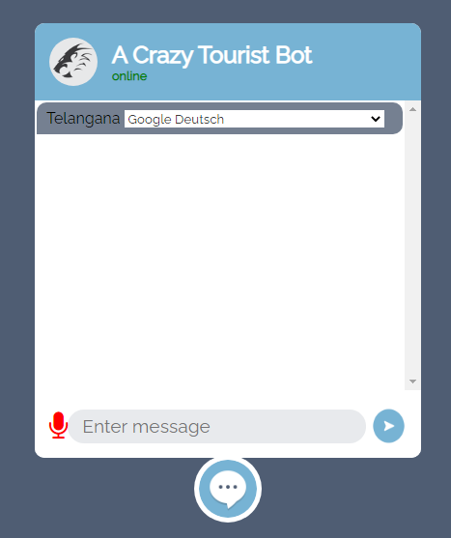



Objective 3: To integrate model with web-application
We built web-application using HTML,CSS, Java Script, Bootstrap and using the Flask integrated our model with web-application.

Slide 9
Literature survey
S.NO | NAME OF THE JOURNAL | YEAR | NAME OF THE AUTHORS | WORK CONTRIBUTED | MERITS AND DEMERITS OF WORK
1 | Critical Literature Review on Chatbots in Education (IJTSRD) | 2020 | Hephzibah Thomas | This paper focuses on text input and text output . And also this paper talks about usage of chat-bots in educational fields. | This paper only uses text to text . Using speech to speech and text to text or text to speech would be much better.
2 | Implementation of Virtual Assistant with Sign Language using Deep Learning and Tensor Flow | 2021 | Vani Valsaraj | This project converts sign language to text using deep learning and tensor flow. | This is explicitly useful for deaf and dumb. If output is in text, output in speech would be better.
3 | Jarvis - A Virtual Assistant based on Artificial Intelligence | 2020 | Dr.M. Sharada Varalakshmi, Dr.P. Lavanya | This paper talks about speech recognition approach. | This paper explained about approach of Speech recognition but not any implementation.
4 | A Review Paper on Smart Personal Assistant | 2016 | Yogendra Kumar Sharma Neeraj Sharma | This Paper talks about overview of applications of Smart Personal Assistant in various fields. | They didn't talk about any architecture Just gave a brief on Smart Personal Assistant.

Slide 10
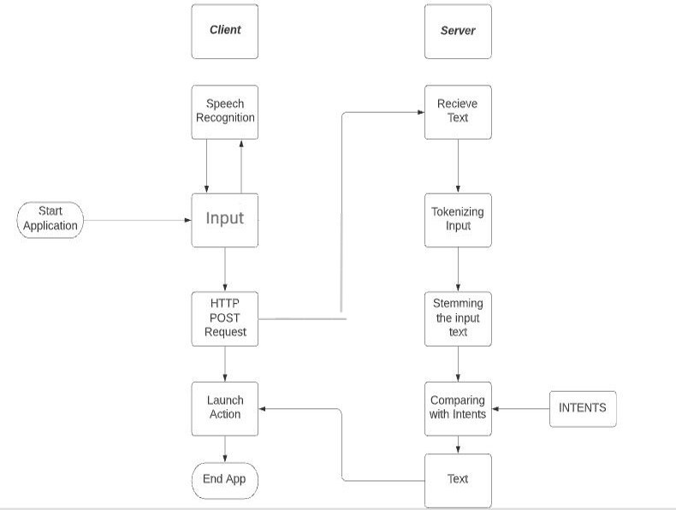
BLOCK DIAGRAM of the project

Slide 11
SOFTWARE(s) USED in the project
Python
PANDAS
NUMPY
Speech Recognition
Natural Language Processing (NLP)
Convolutional Neural Network (CNN)
Tools Used:
Google Collab.
Vs CODE
Python IDLE

Slide 12
RESULT
Input to Output | RS1 | RS2 | RS3 | LATENCY
Text to Text | 0.018ms | 0.015ms | 0.019ms | 0.009ms
Speech to Speech | 0.018ms | 0.015ms | 0.019ms | 0.009ms
RESPONSE TIME: 0.0173ms
LATENCY: 0.009ms

Slide 13
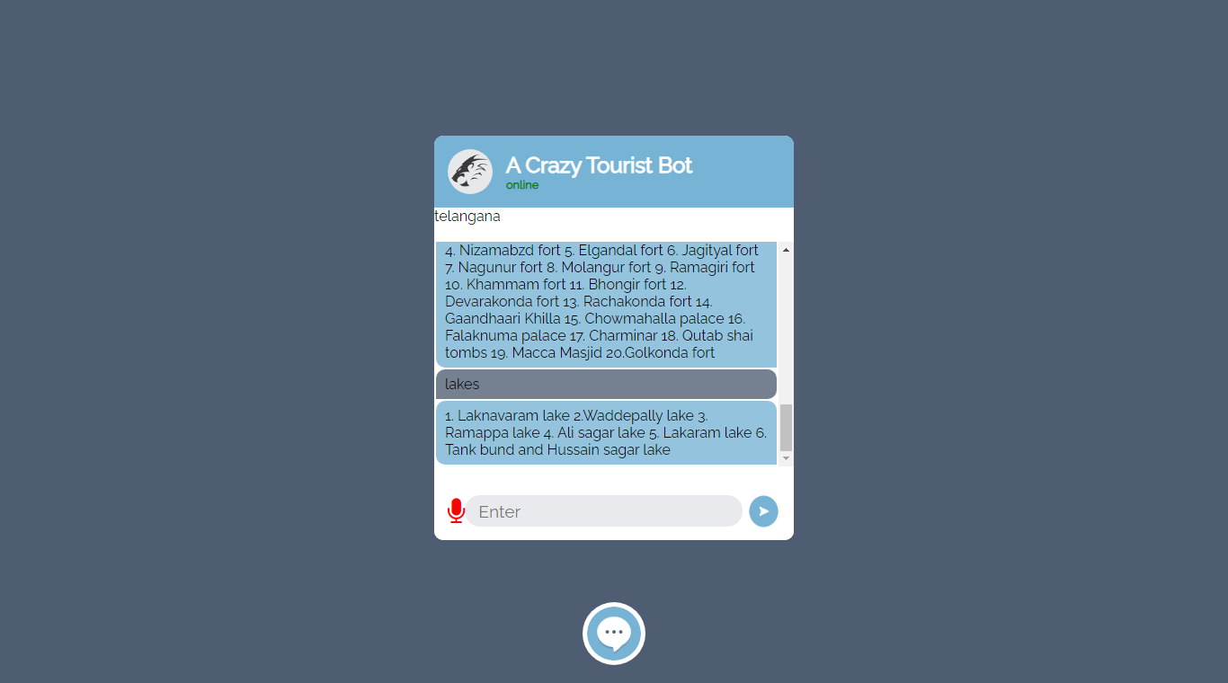
SNAP SHOT OF THE RESULT

Slide 14
CONCLUSION AND Future scope
Virtual Assistant reduces human effort by responding to the queries asked by users. When Virtual Assistant is powered by a deep learning algorithm called Convolutional Neural Network it gives a good response.
CNN model is trained with a data-set consisting of 85 most visited places in telangana whenever a user enters the place name our model processes the data and fetches the result from the data-set.
By Adding the Images and Videos of the respective places, We can enhance the user experience.
Using the API of Google maps, we can integrate maps with our model and we can show directions and review of the places on our webpage itself.
This can also be used for educational purposes, entertainment purposes.

Slide 15
applications
E COMMERCE CINEMA MEDICAL ONLINE GROCERY

Slide 16
PROJECT STEPS
PROJECT STEPS | PROJECT OBJECTIVE DESCRIPTION
STEP 1 | Understanding Virtual Assistant working.
STEP 2 | Understanding Speech recognition, Text to Speech, Speech to Text Conversion.
STEP 3 | Data Collection and Manipulation.
STEP 4 | Writing Code for Entire Project. Training and Testing the model.
STEP 5 | Integrating with Web-Application
STATUS
DONE
DONE
DONE
DONE
DONE

Slide 17
TIME SCHEDULE OF ACTIVITIES
S.NO | TASK | TENTATIVE DATES & DURATION | NO. OF DAYS REQUIRED
1 | Problem statement and picturizing the project | 17-03-2021 to 21-03-2021 | 5
2 | STEP 1 | 26-03-2021 to 02-04-2021 | 7
3 | STEP 2 | 02-04-2021 to 15-04-2021 | 14
4 | STEP 3 | 20-05-2021 to 30-05-2021 | 11
5 | STEP 4 | 25-04-2021 to 10-06-2021 | 45
6 | STEP 5 | 08-06-2021 to 10-06-2021 | 3
7 | Thesis Preparation | 15-06-2021 | 5
8 | Final Slides Preparation | 12-06-2021 | 3

Slide 18
ROLES AND RESPONSIBILITIES
S.NO | NAME OF THE STUDENT | ROLES AND RESPONSIBILTIES
1 | G VAMSHIDHAR(4K5) | Implementation, Data Manipulation, Training and Testing.
2 | N RAJESH(4M5) | Data Collection and Manipulation
3 | RAM PENTAPATI(4N1) | Implementation, Research, Data Handling, Documentation, Training and Testing,
4 | P PAVAN KUMAR(445) | Research, Data Collection and Manipulation.

Slide 19
references
[1] Dr. M. Sharada Varalakshmi, Jarvis - A Virtual Assistant based on Artificial Intelligence, International Journal of Grid and Distributed Computing Vol. 13, No. 2, (2020), pp. 776 – 784
[2] Yogendra Kumar Shar m a , A Review Paper on Smart Personal Assistant, International Journal of Engineering Research & Technology (IJERT) ISSN: 2278-0181 Published by, www.ijert.org V-IMPACT - 2016_2 Conference Proceedings
[3] Hephzibah Thomas , Critical Literature Review on Chatbots in Education , International Journal of Trend in Scientific Research and Development (IJTSRD) Volume 4 Issue 6, September-October 2020 Available Online: www.ijtsrd.com e-ISSN: 2456 – 6470
[4] Vani Valsaraj, Implementation of Virtual Assistant with Sign Language using Deep Learning and TensorFlow, International Journal for Research in Applied Science & Engineering Technology (IJRASET) ISSN: 2321-9653; IC Value: 45.98; SJ Impact Factor: 7.429 Volume 9 Issue I Jan 2021- Available at www.ijraset.com

Slide 20
references
[5] The Alexafication of Adult Social Care: Virtual Assistants and the Changing Role of Local Government in England, International Journal of Environmental Research and Public Health
[6] Nanaware, Rasika. “Chatbot for Education System.”, Corpus ID: 58318311, (2018).
[7] Clarizia F., Colace F., Lombardi M., Pascale F., Santaniello D. (2018) Chatbot: An Education Support System for Student .

Slide 21
Thank you
BATCH-15

